Slide 1
Advanced C++
Pointers, Pass by Reference, Pass by Constant Reference
From: Ch 8 and dynamic memory allocation section comes from Ch 11
(Ch 11 starts on page 469 in latest version of book)
(it is IMPORTANT you understand this for this class)
Fall 2011
Kristina Shroyer

Slide 2
Pointer Review Objectives
You should know the BASICS of pointers from CSIS 135
  What pass by reference is
  What a pointer variable is
It's very important to understand pointers both in this class and if you ever take data structures (CSIS 211)
  I'm going to do a quick review of the basics, review how pointers relate to arrays a bit more slowly and then cover the stuff we didn't get to in CSIS 135 due to time limitations as well as some brand new things
    I will also go over dynamic memory allocation very slowly since I ask you to use this in some of your homework
I've chosen the topics I think are most important to understand
  Your book has some even more advanced topics than I go over here

Slide 3
Addresses and Pointers
High-level languages use memory addresses throughout executable programs
  Keeps track of where data and instructions are physically located inside of computer
Advantage of C++: The programmer is provided access to addresses of program variables
  This access enables a programmer to enter directly into the computer’s inner workings and manipulate the computer’s basic storage structure
  This capability is typically not provided in other high-level languages
This lecture will present the basics of declaring variables to store addresses. Such variables are referred to as pointer variables or simply pointers
  Pointer (Pointer Variable): a variable that stores the address of another variable

Slide 4
Addresses and Pointers
Every variable has three major parts associated with it:
  Its Data type: declared in a declaration statement
  Its Actual Value: Stored in a variable by:
    Initialization when variable is declared
    Assignment
    Input
  Its Address (where the variable is stored in memory): For most applications, variable name is sufficient to locate variable’s contents
    Translation of variable’s name to a storage location (memory address) is done by the computer each time variable is referenced

Slide 5
Addresses and Pointers
Concept: The address operator & returns the memory address of a variable
When a variable is declared it is allocated a section of memory large enough to hold a value of that variable’s data type.
  On a PC it’s common for 1 byte to be allocated for char, 4 bytes for int and float, and 8 bytes for double
  Each byte of memory has a unique address
    A variable’s address is the first byte allocated to that variable

Slide 6
Addresses and Pointers
Illustration of concept of a variable’s memory address: Suppose the following variables are declared in a program:
    char letter; //1 byte
    short number; //2 bytes
    float amount; //4 bytes
The illustration below shows how these variables might be arranged in memory and shows their addresses
  Note that the addresses shown in the figure below are just arbitrary values and are used only for illustration purposes
    In reality, Addresses are NOT stored in decimal notation but instead in hexidecimal
  In the illustration each box represents a byte in memory
  In the illustration the address of letter would be 1200, the address of number would be 1201 and the address of amount would be 1203
    Remember: A variable’s address is the first byte allocated to that variable
letter
number
amount
Addresses:
1200
1201
1203

Slide 7
Addresses and Pointers
This figure illustrates the relationship between the three parts of a variable: type, contents, and location
One or more bytes of Memory (to hold declared data type)
Variable Contents
(the variable’s actual value)
Variable’s Address
(first byte allocated)

Slide 8
Addresses and Pointers
Example #1: Two of the three parts of a variable. Programmers are usually only concerned with the value assigned to a variable and pay little attention to where it is stored (its address)
  /*Example of two of the three items associated with a
  variable*/
  #include <iostream>
  using namespace std;
  int main()
  {
  int num;
  num = 22;
  cout << "The value stored in num is " << num << endl;
  cout << sizeof(num) << " bytes are used to store this variable" << endl;
  return 0;
  }
Notes:
So in this program we can get information on the data type (what size of memory set aside) and on the actual value set aside for the variable but there is no information on the address

Slide 9
Addresses and Pointers
An illustration of the information provided by the previous program (Example #1)
Program output (Example #1):
    The value stored in num is 22
    4 bytes are used to store this variable
    Press any key to continue . . .
4 bytes of Memory (to hold num’s data type of int)
not provided
by program
22
Contents of num
Variable’s Address
(first byte allocated)

Slide 10
Addresses and Pointers
What if we wanted the program to also obtain the address corresponding the variable num?
Address operator &: determines the address of a variable
  & means “address of”
  When the address operator & is placed in front of a variable name it returns the address of that variable
  When placed in front of variable &num, & is translated as “the address of num”
Program 9.2 (shown on the next slide) uses the address operator to display the address of variable num

Slide 11
Addresses and Pointers
Example #2: (AddressOperator.cpp) Using the address operator to display the address of a variable (remember an address is the first byte the variable is stored at in memory)
/*Example of two of the three items associated with a variable*/
#include <iostream>
using namespace std;
int main()
{
int num;
num = 22;
cout << "The value stored in num is " << num << endl;
cout << "The address of num is " << &num << endl;
cout << sizeof(num) << " bytes are used to store this variable" << endl;
return 0;
}
Notes:
What address displays will vary by computer and compiler

Slide 12
Addresses and Pointers
An illustration of the information provided by the previous program (Example #2)
Program output (Example #2):
    The value stored in num is 22
    The address of num is 0x22ff74
    4 bytes are used to store this variable
    Press any key to continue . . .
The address output by this program depends on the computer used to run this program
  However every time this program is executed it displays the address of the first memory byte used to store the variable num
  The address of the variable is displayed in hexadecimal (this is the way addresses are normally shown in C++)
4 bytes of Memory (to hold num’s data type of int)
0x22ff74
22
Contents of num
Variable’s Address
(first byte allocated)

Slide 13
Pointer Variables
Concept: Pointer variables, which are often just called pointers are variables designed to hold memory addresses. With pointer variables you can indirectly manipulate data stored in other variables
Many operations are best performed with pointers and some tasks aren’t possible without them
Some examples of tasks pointers are useful for:
  Working directly with memory locations that regular variables don’t give you access to
  Working with strings and arrays
  Creating new variables in memory while the program is running (this is called dynamically allocating memory for variables)
  Creating arbitrarily sized lists of values in memory

Slide 14
Pointer Variables
Pointers are special variables in C++ designed for working with memory addresses.
  Just like int variables are designed to work with integers, pointer variables area designed to hold and work with addresses
  The definition of a pointer variable (much like any other variable definition):
  //these two declaration styles are both correct
    int *ptr;
    int* ptr;
    The asterisk (star) in front of the variable name indicates that ptr is a pointer variable
    The int data type indicates that ptr can be used to hold the address of an integer type variable
      So in the pointer variable declaration you MUST declare what type of variable the pointer will point to…what type of address will it hold?
      The pointer can ONLY hold an address of the data type specified
    This declaration statement would read “ptr is a pointer to an int”
  NOTE: The word int does NOT mean that pointer is an integer variable. It means that ptr can hold the address of an integer variable. Pointers can only hold one thing: addresses.

Slide 15
Pointer Variables
Example #3: (Pointer1.cpp) This program stores the address of a variable in a pointer
/*This program stores the address of a variable in a pointer and prints the address*/
#include <iostream>
using namespace std;
int main()
{
int x = 25;
int *ptr; //ptr is a pointer to an int
ptr = &x; //store the address of x in ptr
cout << "The value in x is " << x << endl;
cout << "The value in ptr is " << ptr << endl;
return 0;
}

Slide 16
Pointer Variables
Example #3: This program stores the address of a variable in a pointer
  Program Output:
      The value in x is 25
      The value in ptr is 0x22ff74
      Press any key to continue . . .
  Two variables are defined in the program: x and ptr.
    The variable x is initialized with 25
    The variable ptr is assigned the address of x with the following statement
      ptr = &x;
    The figure below illustrates the relationship between ptr and x
    The variable x is located at memory address 0x22ff74 while the pointer variable ptr contains the address 0x22ff74.
      In essence ptr “points” to the variable x
x
25
Address of x: 0x22ff74
ptr
0x22ff74

Slide 17
Pointer Variables
Pointers can allow you to indirectly access and modify the variable being pointed to
  In Example 3 the ptr variable could be used to indirectly modify the contents of the variable x
    This is done with the indirection operator, which is an asterisk (*)
    The * symbol when followed by an already declared pointer variable means “the variable whose address is stored in”
      Thus the *ptr would mean “the variable whose address is stored in” ptr
    When you use the indirection operator it is called dereferencing a pointer
      When you dereference a pointer you are actually working with the value the pointer is pointing to
      Best seen with an example

Slide 18
Pointer Variables
Example #4: (Pointer2_IndirOp.cpp) Dereferencing a pointer
/*This program demonstrates the use of the indirection operator on a pointer(dereferencing a pointer)*/
#include <iostream>
using namespace std;
int main()
{
int x = 25;
int *ptr; //ptr is a pointer to an int
ptr = &x; //store the address of x in ptr
cout << "Here is the value of x printed twice: "
<< "x = " << x << " *ptr = " << *ptr << endl;
*ptr = 100; //we have actually changed the value pointed to by ptr //(which is x) - this is because when you work with a //dereferenced pointer you are actually working
//with the value the pointer is pointing to
cout << "Here is the new value of x printed twice: "
<< "x = " << x << " *ptr = " << *ptr << endl;
return 0;
}

Slide 19
Pointer Variables
Example #4: This program stores the address of a variable in a pointer
  Program Output:
      Here is the value of x printed twice: x = 25 *ptr = 25
      Here is the new value of x printed twice: x = 100 *ptr = 100
      Press any key to continue . . .. .
  Every time the expression *ptr appears in the program, the program indirectly uses the variable x
    With the indirection operator, ptr can be used to indirectly access the variable it is pointing to
      With this indirect access *ptr is even able to modify x in this example
x
25
Address of x: 0x22ff74
ptr
0x22ff74
The value of *ptr is 25

Slide 20
Pointer Variables
Example #5: (Pointer3.cpp) Pointers can point to different variables
/*This program demonstrates the ability of a pointer to point to different
variables*/
#include <iostream>
using namespace std;
int main()
{
int x = 2, y = 2, z = 2;
int *ptr; //ptr is a pointer to an int
cout << "Original Values: x = " << x << " y = " << y << " z = " << z << endl;
ptr = &x; //store the address of x in ptr
*ptr = *ptr * 2; //we are indirectly changing the value in x
ptr = &y; //store the address of y in ptr
*ptr = *ptr * 3; //we are indirectly changing the value in y
ptr = &z; //store the address of z in ptr
*ptr = *ptr * 4; //we are indirectly changing the value in z
cout << "Modified Values: x = " << x << " y = " << y << " z = " << z << endl;
return 0;
}

Slide 21
Pointer Variables
Example #5: Pointers can point to different variables
  Program Output:
      Original Values: x = 2 y = 2 z = 2
      Modified Values: x = 4 y = 6 z = 8
      Press any key to continue . . .
    Every time the expression *ptr appears in the program, the program indirectly accesses and modifies the value of the variable pointer is pointing to (ptr is pointing to the variable stored located in the address stored in it)
You’ve seen three different uses of the asterisk *(star) in C++
  As the multiplication operator ( distance = speed * time;)
  In the definition of a pointer variable (int* ptr;)
  As the indirection operator (*ptr = 100;)

Slide 22
Relationship Between Arrays and Pointers
An array name without the brackets and subscript actually represents the starting address of the array in memory
  This means that an array name is really a pointer to the starting memory address of the array which holds the first element (Example #6) (Array1.cpp)
  /*This program shows an array name being dereferenced with the * operator*/
  #include <iostream>
  using namespace std;
  int main()
  {
  short numbers [] = {10,20,30,40,50}; //declares and initializes an array //of 5 shorts
  //the array name numbers is a pointer to the beginning of the array, the //first element is stored in the first memory location the array name is //pointing to
  //Notice that numbers is dereferenced so we print the value in the first //element of the array rather than the address of the first element in the //array
  cout << "The first element of the array is " << *numbers << endl;
  return 0;
  }
  Remember an array of ints is a list of ints stored sequentially in memory
Notes:
Remember why I used a short…make note of the numbers array on the board…it's an array of 5 shorts

Slide 23
Relationship Between Arrays and Pointers
Example #6 An array name is really a pointer (Example #6)
  Output:
    The first element of the array is 10
    Press any key to continue . . .
Because numbers in our numbers array works like a pointer to the starting address of the array, the first element was retrieved when numbers was de-referenced using the indirection operator *
Remember Array Elements are stored together in memory as shown in the figure below
  A short is normally two bytes so the figure shows two bytes being allocated for each array element
numbers[0]
numbers[1]
numbers[2]
numbers[3]
numbers[4]
numbers
Notes:
..the way the array is stored in memory is going to allow us to be able to use pointers to access all of the elements of the numbers array…this starts on next slide

Slide 24
Relationship Between Arrays and Pointers
The entire array could be retrieved using pointers and the indirection operator (*) – de-referenced pointers
  If numbers is the address of numbers[0], certain values can be added to numbers to get the addresses of other elements in the array since the values are stored sequentially in memory
  However, pointers do NOT work like regular variables when used in mathematical statements
    In C++ when you add a value to a pointer you are actually adding that value multiplied by the size of the data type being referenced by the pointer
    So if you add 1 to numbers you are actually adding 1 * sizeof(short) to numbers
    If you add 2 to numbers you are adding: 2* sizeof(short) to numbers
numbers[0]
numbers[1]
numbers[2]
numbers[3]
numbers[4]
numbers
Notes:
So we want to be able to start with the address of numbers in our array and add a number to that address to get the address of the second element in the array so we can dereference that element and get its value

Slide 25
Relationship Between Arrays and Pointers
On the PC this means the following is true because short integers usually use 2 bytes:
    *(numbers + 1) is actually *(numbers + (1 *2))
    *(numbers + 2) is actually *(numbers + (2 *2))
    *(numbers + 3) is actually *(numbers + (3 *2))
    *(numbers + 4) is actually *(numbers + (4 *2))
This automatic conversion means that an element in an array can be retrieved using its subscript or by adding its subscript to a pointer to the array
  If the expression *numbers (which is the same as *(numbers +0) ) retrieves the first element in the array then *(numbers + 1) retrieves the second element and so on
  The parenthesis are CRUCIAL when adding values to pointers
    The * operator has precedence over the + operator
    *numbers + 1 is NOT equivalent to *(numbers + 1)
    *numbers + 1 dereferences the first element in the array and then adds one to the value of the first element in the array while *(numbers + 1) adds one to the address in numbers and then dereferences it
numbers[0]
numbers[1]
numbers[2]
numbers[3]
numbers[4]
numbers

Slide 26
Relationship Between Arrays and Pointers
Example #7: (Array2.cpp) Program to Process an array using pointer notation
/*This program shows an array being processed with pointers*/
#include <iostream>
using namespace std;
int main()
{
short numbers [] = {10,20,30,40,50}; //declares and initializes an array //of 5 ints
//adds 1 * sizeof(short) to the pointer numbers to access the second //element of the array an so on through all of the array elements
cout << "The first element of the array is " << *numbers << endl;
cout << "The second element of the array is " << *(numbers + 1) << endl;
cout << "The third element of the array is " << *(numbers + 2) << endl;
cout << "The fourth element of the array is " << *(numbers + 3) << endl;
cout << "The fifth (last) element of the array is " << *(numbers + 4) << endl;
return 0;
}
Look at example with () around numbers + subscript value taken out – it won’t work correctly

Slide 27
Relationship Between Arrays and Pointers
Example #8: (Array3.cpp) Program to Process an array using pointer notation – a loop is added to Example #7
/*This program shows an array being processed with pointers*/
#include <iostream>
using namespace std;
int main()
{
short numbers [] = {10,20,30,40,50}; //declares and initializes an array //of 5 ints
//adds 1 * sizeof(short) to the pointer numbers to access the second //element of the array an so on through all of the array elements
for(int index = 0; index < 5; index++)
{
cout << "numbers[" << index << "] = "<< *(numbers + index) << endl;
}
return 0;
}
Notes:
So it first adds the index to the address of the first element of the array and then dereferences the element at that address

Slide 28
Relationship Between Arrays and Pointers
Example #8: Program to Process an array using pointer notation – a loop is added to Example #7
  Output:
    numbers[0] = 10
    numbers[1] = 20
    numbers[2] = 30
    numbers[3] = 40
    numbers[4] = 50
    Press any key to continue . . .
  When working with arrays and pointers remember the following is true
    array[index] is equivalent to *(array + index)

Slide 29
Initializing Pointers
Concept: Pointers may be initialized with the address of an existing object
  Question: if nothing is saved in a variable (pointer or otherwise) what does that variable contain (esp relevant in C++)
Remember a pointer is designed to point to a the address of a specific type of data (int, double etc)
  When a pointer is initialized it must be initialized to the type of data it was designed to point to
  LEGAL INITIALIZATIONS:
      int myValue;
      int *ptr = &myValue; //myValue is an int and ptr is designed to point //to an int
      int ages[20];
      int *ptr = ages; //legal because ages is the special pointer of the //first int in an array of integers
      //pointers may be defined in the same statement as other variables of
      //the same type, ptr is a pointer to an int initialized to the address
      //of myValue
      int myValue, *ptr = &myValue;
      //the following defines an array of doubles readings and a pointer to
      //a double, marker, that is initialized with the first element in the
      //array
      double readings[50], *marker = readings;
  ILLEGAL:
      float myFloat;
      int *ptr = &myFloat; //ILLEGAL myFloat is NOT an int
      //pointer can only be initialized to with the address of an object that
      //has been defined
      int *ptr = &myValue; //ILLEGAL, myValue is not defined yet
      int myValue;

Slide 30
Initializing Pointers
Initializing pointers to NULL
  In most computers the memory address at 0 is inaccessible to user programs because it is occupied by operating system data structures
    This fact allows programmers to signify that a pointer does not point to a memory location accessible to the program by initializing the pointer to 0
    By initializing a pointer to 0 (NULL) the programmer is initializing the pointer by not having it point to anything
      NULL is a constant defined in many header files and has a value of zero
      If not initialized the pointer may try to point to something unexpected
  LEGAL INITIALIZATIONS:
      //Both of these pointers point to 0, indicating that neither
      //is pointing to a legitimate address
      int *ptrToInt = 0;
      float *ptrToFloat = 0;
      //Many header files that are used often such as iostream and
      //fstream define a constant named NULL whose value is zero
      int *ptrToInt = NULL;
      float *ptrToFloat = NULL;
    A pointer whose value is the address zero is often called the null pointer
Notes:
NULL is a constant defined in many header files and has a value of zero

Slide 31
Comparing Pointers
Pointers may be compared using any of C++’s relational operators: >,<,==,!=,<=, >=
  If one address comes before another in memory, the first address is considered less than the second
    In an array all of the elements are stored in consecutive memory locations
      This means the address of element 1 in an array is greater than the address of element 0

Slide 32
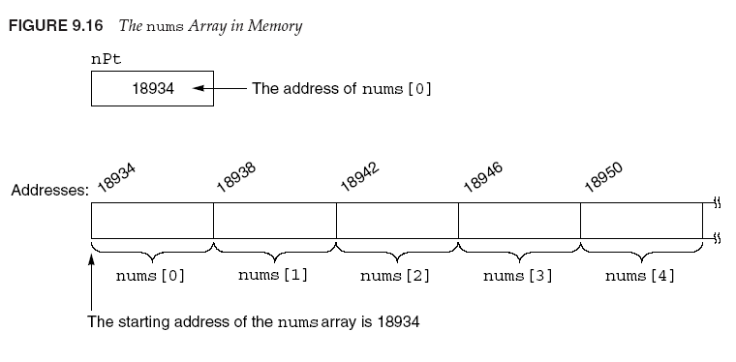
Comparing Pointers
Because addresses grow larger for each subsequent element in an array the
Following are all true for the nums array shown above:
&nums[1] > &nums[0];
nums < &nums[4];
nums = = &nums[0];
&nums[2] != &nums[3];

Slide 33
Comparing Pointers
Comparing two pointers is not the same as comparing the values two pointers point to
  The following statement compares the addresses stored in ptr1 and ptr2
    if(ptr1 > ptr2)
  The next statement however, compares the values ptr1 and ptr2 point to
    if(*ptr1 < *ptr2)

Slide 34
Comparing Pointers
Example #9 (ComparePtr.cpp) – This program shows how you can use addresses to make sure a pointer does not go beyond its boundaries
/*This program uses a pointer to display the contents of an integer array. It illustrates the comparison of pointers*/
#include <iostream>
using namespace std;
int main()
{
const int SIZE = 8; //to use as the array size
int set[] = {5,10,15,20,25,30,35,40}; //declare and initialize an array of 8 ints
int *nums = set; //nums is pointing to set (the first element in the array
//use the pointer to nums print out the set array
//while the address of nums is less than the address of set[8]
while(nums < &set[SIZE]) //comparing the pointer num to the address of set[8]
{
cout << *nums << " " << endl;
nums++;
}
return 0;
}
Notes:
Remember nums contains the address of the first element of the array so nums ++ is adding 1 * sizeof(int) to the current address in nums and saving it there

Slide 35
Comparing Pointers
Most comparisons involving pointers compare a pointer to NULL (0) to determine whether or not the pointer points to a legitimate address
  This is why it’s a good idea to initialize pointers either to an address right away or to null right away
    These kind of comparisons can catch errors in your code where you might be trying to use a pointer that is not initialized properly or pointing to what you want it to be
  Assuming ptrToInt has been defined as a pointer to an integer, the following code prints the integer pointed to by ptrToInt only after checking that the pointer is not NULL
    if(ptrToInt != NULL)
    cout << *ptrToInt;
    else
    cout << “null pointer”;

Slide 36
Pointers as Function Parameters
Concept: A pointer can be used as a function parameter. It gives the function access to the original argument passed to the function much like a reference parameter does
In CSIS 135, you learned how to use reference variables as function parameters
  A reference variable acts as an alias to the original variable used as an argument
  When a variable is passed into a function parameter that contains a reference parameter the argument is said to be passed by reference

Slide 37
Pointers as Function Parameters – Example Pass by Reference
/*This program passes variables by reference into two functions*/(Example 10-PassByRef.cpp)
#include <iostream>
using namespace std;
void getNumber(int&);
void doubleValue(int&);
int main()
{
int number;
getNumber(number); //the variables are passed by reference to the function
cout << "\nThe number input was " << number << endl;
doubleValue(number); //the details of how it works are hidden
cout << "The value of number doubled is " << number << endl;
return 0;
}
//since the parameter is passed by reference the variable passed to this function is
//altered by the function
void getNumber(int& input)
{
cout << "Please enter a number: ";
cin >> input;
}
//since the parameter is passed by reference the variable passed to this function is
//altered by the function
void doubleValue(int& value)
{
value = value *2;
}
Review: When should we use pass by reference
versus pass by value? Is it possible to use pass
by reference incorrectly? How?

Slide 38
Pointers as Function Parameters
An alternative to passing a argument to a function by reference is to use a pointer value as the parameter in the function
  This is essentially the same as passing by reference
  Passing by reference is simpler
    However, reference variables hide the mechanics behind the dereferencing and indirection
      so if you pass by reference you can't use the indirection operator inside your function
    There may be tasks (especially when dealing with C-Strings and dynamic memory allocation) where that are best done passing pointers rather than passing by reference
  Here is the doubleVal function in the previous program with a pointer passed to it instead of a reference variable
      void doubleValue(int *value)
      {
      *value = (*value) * 2;
      }
    When value is dereferenced with the *, the multiplication operator works on the value pointed to by value
      This statement *value = (*value) * 2; multiplies the original variable passed into the function by 2
    Here is the function call for this function that takes a pointer parameter
      doubleValue(&number);
      This statement uses the & operator to pass the address of number into the value parameter
    The next example shows the previous pass by reference example passing pointers instead
      The results are the same
Notes:
Show examples of what would happen without parenthesis…the * dereference operator has precedence over the * multiplication operator

Slide 39
Pointers as Function Parameters – Example Passing Pointers
/*This program uses two functions that accept pointers as arguments*/ (Example 11)_
#include <iostream>
using namespace std;
void getNumber(int*); //The functions now take pointer parameters
void doubleValue(int*);
int main()
{
int number;
getNumber(&number); //the address of the variable is passed to the function
cout << "\nThe number input was " << number << endl;
doubleValue(&number); //the address of the variable is passed to the function
cout << "The value of number doubled is " << number << endl;
return 0;
}
//since the parameter is a pointer so an address should be passed to it
void getNumber(int* input)
{
cout << "Please enter a number: ";
cin >> *input; //The * is necessary to store the value entered by the user
}
//since the parameter is a pointer so an address should be passed to it
void doubleValue(int* value)
{
*value = (*value) *2; //The parenthesis ensure the order of operations
}

Slide 40
Dynamic Memory Allocation
Pointers can be used to create and destroy variables while a program is running
Why would we want to do this?
As long as we know how many variables we need in a program we can define those variables before we use them in our program.
  Examples:
    program to calculate the area of a circle – we need the radius and PI
    program to calculate the payroll data for 30 employees
      We would probably create an array of 30 elements for this (an array of structs or objects)
  Remember we needed to define variables before we can use them in our programs
    You get a compile time error in your program if you try to use a variable that hasn't been defined
  In addition remember with arrays the size is fixed, the array size must be defined at compile time and cannot change while the program is running.
But what if we don't know how may variables we need in a program?
  What if we want a program that calculates payroll data for ANY NUMBER of employees?
  What if we want to write a program that will calculate the average of ANY NUMBER of student tests?
  These types of programs would be nice because they would be very versatile but how can we store the individual data items in memory if we don't know how many variables to define?
    What we want to do is have a program that us able to do is create variables "on the fly"
Notes:
One of the big uses of pointers is to create and destroy variables while a program is running

Slide 41
Dynamic Memory Allocation
Dynamic Memory Allocation: To dynamically allocate memory means that a program, while running, asks the computer to set aside a chunk of unused memory large enough to hold a variable of a specific data type
  Remember so far in our programs we have had to have all variables defined before they could be used otherwise we got compilation errors
    This was so the compiler could have the required memory set aside to run the program
  We still need to have variables defined before we can use them but with dynamic memory allocation we're going to be able to define/create variables on the fly at RUN TIME (not at compile time)
How will a program dynamically allocate memory for a variable of a specified data type (say an int)?
  While running, the program will make a request to the computer that it allocate enough bytes to store an int
  The computer fulfills this request by finding and setting aside a chunk of unused memory large enough to hold a variable of the requested type (an int in this case).
  The computer then gives the program the starting address of the chunk of memory it set aside
  Since the program only has the starting address of the chunk of memory the computer set aside for it the program will only be able to access this newly allocated memory using its address – This means a pointer is required to access these memory bytes
Free store/heap
  Dynamically allocating memory this way causes an array or other dynamically allocated type to be created on what's called the free store
  Sometimes called the heap
  Region of memory assigned to each program for storing objects created at execution time

Slide 42
The new operator
The way a C++ program requests dynamically allocated memory is by using the new operator
Let's say our program wants to dynamically create an int type variable while a program is running
  First the program needs to define a pointer to an int:
    int *intPtr;
  Here is an example of how intPtr can be used with the new operator:
    intPtr = new int;
    This statement is requesting that the computer allocate enough memory for a new int variable
    The operand of the new operator is a data type (in this case int) of the variable being created
    The new operator returns an address to memory allocated for the requested data type
    Once the above statement executes, intPtr will contain the address of the newly allocated memory
  A value can be stored in this dynamically created variable by dereferencing the pointer
    *intPtr = 25;
Pool of unused memory
intPtr variable
0xA654
For this example let's say
this chunk of memory
starts at address 0xA654
Notes:
Now you have created a variable at runtime that you can use in your program

Slide 43
The new operator
The way a C++ program requests dynamically allocated memory is by using the new operator
    int *intPtr;
    intPtr = new int;
    *intPtr = 25;
Operations can be performed on the new variable by simply using the dereferenced pointer – Examples:
  cout << *intPtr << endl;
  cin >> *intPtr;
  total = total + *intPtr;
Pool of unused memory
intPtr variable
0xA654
For this example let's say
this chunk of memory
starts at address 0xA654

Slide 44
The new operator – Dynamic Array Allocation
There's not a lot of point in dynamically allocating a single variable
A more practical use of dynamic memory allocation is to use the new operator to dynamically allocate an array
  This will allow us to create arrays of any size as the program is running
  Remember before we had to have the array size determined at compile time so we could NOT let the user enter the size of the array
The following code dynamically allocates a 100-element array of integers
  int *intPtr;
  intPtr = new int[100];
Once the array is created, the pointer may be used with subscript notation to access it. Here's a for loop that could be used to store the value 50 in each element of the array:
  for(int i = 0; i < 100; i++)
  {
  intPtr[i] = 50;
  }

Slide 45
The new operator – Dynamic Array Allocation
What if we tried to dynamically allocate an array and there wasn't enough memory to accommodate our request?
  What if the program asks for a chunk of memory large enough to hold an 100,000 element array of ints but that much memory isn't available?
    The program cannot continue to operate normally and in most cases will terminate
In newer versions of C++ when memory cannot be allocated, the new operator will by default cause the termination of the program with an appropriate error message in a process called throwing an exception
In older versions of C++, the new operator returns the address of 0 (NULL) if it cannot allocate the requested memory
  In these older version of C++, a program calling/using new should first check the address returned by new and make sure it is not 0 before using it.
  So in an older version of C++ you might do something like this:
  //for older versions of C++
  if(intPtr == NULL)
  {
  cout << "Error Allocating Memory" << endl;
  exit(1);
  }

Slide 46
The delete operator
When a program is finished using a dynamically allocated chunk of memory, it should release that memory for future use
  You don't want chunks of memory no longer being used reserved so they can't be reused
    If you fail to release the memory it will stay reserved and won’t be able to be used by other programs either
The delete operator is used to free memory that was allocated with new
Here's how the delete operator can be used to free a single variable
  delete intPtr;

Slide 47
The delete operator
If intPtr points to a dynamically allocated array the [] symbol must be placed between delete and intPtr to free the array
  delete [] intPtr;
Any memory allocated in the constructor of a class should be deallocated in the destructor of a class
WARNING: Only use the delete operator with pointers that were previously used with new. If you use a pointer with delete that does NOT reference dynamically allocated memory (a regular pointer not used with new) unexpected problems could (and usually will) result.

Slide 48
Dynamic Memory Allocation – Example 11a (Example11a.cpp)
#include <iostream>
#include <iomanip>
using namespace std;
int main()
{
double *sales; //a pointer to a double - we'll use it to point to our dynamically allocated memory
double total = 0;
double average;
int numDays;
cout << "How many days to you wish to process sales figures for?" << endl;
cin >> numDays; //this is how big we want our array to be – unknown until runtime
sales = new double[numDays]; //dynamically allocate memory for the array of the user input size
//now get the sales figures from the user
cout << "You will enter the sales figures for each day below:" << endl;
for(int i = 0; i < numDays; i++)
{
cout << "Day " << (i + 1) << ": ";
cin >> sales[i];
}
//calculate total sales
for(int i = 0; i < numDays; i++)
{
total = total + sales[i];
}
average = total/numDays;
cout <<fixed << setprecision(2) << "\nTotal Sales = " << total << "\nAverage Sales = "<< average << endl;
delete [] sales; //don't forget to free the dynamically allocated memory
return 0;
}
Notes:
--This program allows the user to enter sales numbers of ANY amount of days they would like and stores those figures in a dynamically allocated array…the program then calculates the total of the sales figures and the average

Slide 49
Returning Pointers from Functions
Functions can return pointers, but you must make sure the object the function is referencing still exists when the pointer is returned
Example: This function locates the null terminator '\0' (the last character in a C-Style string) and returns a pointer to it (since the null terminator is a char the function returns a pointer to a char)
  Remember a C-string is just an array of characters so we're passing a pointer to the first element of the string array into the function
  This example is OK
char *findNull(char *str)
{
char *ptr = str;
  while(ptr != '\0')
  {
  ptr++;
  }
  return ptr;
  }
The char * return type in the function header indicates the function returns a pointer to a char

Slide 50
Returning Pointers from Functions
Be careful when writing functions that return pointers – they can contain elusive bugs
Example: What's wrong with the following function?
char *getName()
{
char name[81]; //a C-string with 80 chars plus '\0'
cout << "Enter your name;
cin.getline(name,81); //a special getline for C-Style Strings
  return name; //name would be a pointer to the first element of the
  //char array
  }
The problem?
  The function returns a pointer to an object that no longer exists
  Because name is a local array the function getName, it is destroyed when the function returns
  Since the returned pointer points to an object that no longer exists attempting to use the pointer will result in unpredictable results and errors

Slide 51
Returning Pointers from Functions
Be careful when writing functions that return pointers – they can contain elusive bugs
RULES: Only return a pointer from a function if it is:
  A pointer to an object passed into the function as an argument
  A pointer to a dynamically allocated object
Corrected Function
char *getName(char *name)
{
cout << "Enter your name;
cin.getline(name,81); //assigns user input to name array
  return name; //name would be a pointer to the first element of //the char array
  }
Now name points to a memory location that was valid before the function was called so it sill exists after the function exits

Slide 52
Pointers to Structures
Concept: You can create pointers that point to structures
Declaring a variable that is a pointer to a struct is the same as declaring any other pointer variable: the data type followed by an asterisk and the name of the pointer variable:
    struct Circle //the Circle structure type
    {
    double radius;
    };
    Circle piePlate; //declare a variable of type circle
    Circle *circPtr; //declare a pointer to a Circle Structure
    circPtr = &piePlate //store the address of piePlate in the
    //circPointer variable
    //to dereference the circle pointer parenthesis must be used
    //the dot operator has higher precedence than the indirection operator
    (*circPtr).radius = 10; //sets piePlate’s member radius to 10
    //A special operator called the structure pointer operator can be
    //used to dereference both structs and objects using pointers
    circPointer ->radius = 10; //does the same thing as the previous statement
Notes:
What happens without the parenthesis….THE DOT OPERATOR HAS HIGHER PRECEDENCE THAN THE INDIRECTION OPERATOR…so without the parenthesis the indirection operator tries to dereference &piePlate.radius instead of piePlate…remember circPtr is a pointer to a circle not a pointer to a double…so with this dereference you would get an error
--the parenthesis make it so first circPtr is dereferenced and then the dot operator is used to access the members of the Circle circPtr is pointing to
--Because of the awkwardness of the notation C++ has a special operator for dereferencing structure pointers…the -> this is called the structure pointer operator…this operator automatically dereferences the item to the left of the dot operator before access the member following the dot operator

Slide 53
Pointers to Structures – Example 12 (StructPointers.cpp)
/*This program illustrates the use of pointers to structs*/
#include <iostream>
using namespace std;
int main()
{
struct Circle //declare the type Circle
{
double radius;
};
Circle piePlate; //declare a variable of type Circle
Circle *circPtr; //declare a pointer to a Circle Structure
circPtr = &piePlate; //store the address of piePlate in the circPointer variable
//set piePlate's member radius to 10 using the circPointer
circPtr->radius = 10;
cout << "piePlate's radius is " << circPtr->radius << endl;
return 0;
}
Notes:
Show the different notations..and the one without parenthesis

Slide 54
Pointers to Class Objects - Example 13
Concept: You can create pointers that point to class objects (instances of classes)
  If you go into game programming you will see this a lot/ Works very similarly to stucts
The Circle class we went over last time;
class Circle //class declaration
{
private:
double radius;
public: //function prototypes
void setRadius(double);
double getRadius();
double getArea();
};
void Circle::setRadius(double r) //start of the implementation section
{
if(r > 0)
radius = r;
else
radius = 0;
}
double Circle::getRadius()
{
return radius;
}
double Circle::getArea()
{
return 3.141592 * pow(radius,2);
}

Slide 55
Pointers to Class Objects
Concept: You can create pointers that point to class objects (instances of classes)
  If you go into game programming you will see this a lot/ Works very similarly to stucts
Using pointers with the circle class
  Circle circ1; //instantiate a variable of type Circle
  Circle *circPtr; //define a pointer to a circle called //circPtr
  circPtr = &circ1; //circPtr points to the circ1 object //(contains circ1’s address)
  //the cirPtr can then be used to call circ1’s member
  //functions using the -> operator
  circPtr->setRadius(15); //sets circ1’s radius to 15
  double area;
  area = circPtr->getArea() //calls circ1’s getArea //member function and stores
  //it in the area variable
See Example

Slide 56
Pointers to Class Objects
Example: Pointers to Class Objects (Example 13)
#include <iostream>
#include "Circle.h"
using namespace std;
int main()
{
Circle circ1; //instantiate a variable of type Circle
double area; //to hold the area of the circle after its calculated
Circle *circPtr; //define a pointer to a circle called circPtr
circPtr = &circ1; //circPtr points to the circ1 object (contains circ1’s //address)
//the cirPtr can then be used to call circ1’s member
//functions using the -> operator
circPtr->setRadius(10); //sets circ1’s radius to 10
area = circPtr->getArea(); //calls circ1’s getArea member function and stores
//the result in the area variable
cout << "circ1's radius is " << circ1.getRadius() << " and the area is " << area << endl;
return 0;
}

Slide 57
Dynamically Allocating Class Objects and Structs
Class objects and struct type variables may be dynamically allocated in memory just like other variable types
For example assume a class named Rectangle exists and the following pointer to a Rectangle is declared in a program
  Rectangle *boxPtr;
You may use the pointer above to dynamically allocate an object of the Rectangle class like this:
  boxPtr = new Rectangle;
When the new operator creates the Rectangle class object in memory, its constructor is executed.
  Since the constructor is executed you may pass arguments to the dynamically allocated object's constructor like this:
  boxPtr = new Rectangle(10,20);
The delete operator destroys dynamically allocated objects:
  delete boxPtr;

Slide 58
Dynamically Allocating Class Objects
Often in a class definition the constructor dynamically allocates memory
What if you wanted to have an array member of your class but wanted the array to be any length?
  You need a pointer in your class and you want to dynamically allocate the array when the object is created
If you dynamically allocate a member of an array when an object is created in a constructor you also need to free up that memory when the object is destroyed
  Remember a destructor is run when an object is destroyed
The next example shows how to have a dynamically allocated array as a class member
  We will do a homework implementing something like this at some point
Pay attention to this and the next example…this is what you're doing in
Homework #2 (and possibly HW #3 as well) !!!!!

Slide 59
Example 14
#include <iostream>
#include <string>
using namespace std;
class StatsArray
{
private:
double *list;
int listSize;
public:
StatsArray(int);
void displayArray();
~StatsArray();
};
StatsArray::StatsArray(int size)
{
list = new double[size];
listSize = size;
for(int i = 0; i < size; i++) { //initializes all array values to 5.1
list[i] = 5.1;
}
}
StatsArray::~StatsArray()
{
delete [] list;
}
void StatsArray::displayArray()
{
for(int i = 0; i < listSize; i++) {
cout << list[i] << endl;
}
}
int main()
{
int arrSize;
cout << "How big would you like the array to be?" << endl;
cin >> arrSize;
StatsArray arr(arrSize);
arr.displayArray();
}

Slide 60
Common Programming Error 10.8
Not releasing dynamically allocated memory when it is no longer needed can cause the system to run out of memory prematurely. This is sometimes called a “memory leak.”

Slide 61
Common Programming Error 10.9
Using delete instead of delete[] for arrays of objects can lead to runtime logic errors.
  With delete[] this operation first calls the destructor for every object in the array and then de-allocates the memory
  To ensure that every object in the array receives a destructor call, always delete memory allocated as an array with operator delete[] .
  Similarly, always delete memory allocated as an individual element with operator delete
    otherwise, the result of the operation is undefined.

Slide 62
Passing Objects as Function Arguments
Passing an entire object as a Function Argument
      showRect(box);
      void showRect(Rectangle r)
      {
      cout << r.getLength() << endl;
      cout << r.getWidth() << endl;
      cout << r.getArea() << endl;
      }
  Once the function is called r's member variable length contains a copy of box's member variable length, and r.width contains a copy of box's member variable width
  By default class instances (objects) are passed to functions by value as shown here – THIS IS DIFFERENT THAN JAVA!!!
See Example 15

Slide 63
Passing Objects as Function Arguments– Pass by Reference
Pass by value has an advantage for a object if the function does not need to have access (be able to modify) to the members of the original object argument (remember the principle of least privilege)
  NOTE: anything I do to the r Rectangle inside showRect does not happen to box (let's try it)
  If a function needs to have access to the original object the object should be passed by reference
  Remember passing by reference passes the address of the argument (in this case a object) giving the function access to the actual object (instance)
  HOWEVER think of all the space wasted copying a object with a large number of members in it
Example 16
  Now I'll pass the rectangle to the function by reference so any changes that happen to the rectangle in the function also happens to the argument (rectangle passed into the function)

Slide 64
Constant Reference Parameters
Disadvantages of Passing an Object by Value
  If a object has a lot of members passing an object by value can slow down a program’s execution time
    This is because when an argument is passed by value a copy of it is created
      For an object argument passed by value each of its member variables must passed so a copy of each member variable must be created
When a argument is Passed by Reference a copy of it is not created
  Only a reference that points to the original argument is passed
  The disadvantage of pass by reference however is that the function has access to the original argument (all of a structure’s members in this case) and can alter the argument’s value (all member values)
    This violates the principle of least privilege
Solution: Pass the argument by a constant reference

Slide 65
Constant Reference Parameters
Solution: Pass the argument by a constant reference
  When an argument is passed by constant reference this means that only a reference to the original variable is passed to the function BUT the argument cannot be changed by the function – so we minimize memory use and keep the principle of least privilege
  To declare that a function parameter will receive a constant reference the keyword const must be placed in the parameter list of the function prototype and the function header
  Revised showRect function
    void showRect(const Rectangle&) //function prototype
    void showRect(const Rectangle& r ) //function header
Example 17
Whenever you make an argument
of a function const, the function cannot change that argument
When possible I usually pass objects
by constant reference in C++ to save
memory and keep the principle of least
privilege

Slide 66
Using const with pointers
const qualifier
  remember const indicates that value of variable should not be modified
  const should be used in a function when the function does not need to change the variable’s value (we could be talking about the parameters or the return type)
Principle of least privilege
  Use the principle of least privilege when deciding whether or not to use const
    Award the function enough access to accomplish task, but no more
  Example
    A function that prints the elements of an array, takes two parameters: an array and int indicating length
      Array contents are not changed – should be const
      Array length is not changed – should be const

Slide 67
Software Engineering Observation 8.2
If a value does not (or should not) change in the body of a function to which it is passed, the parameter should be declared const to ensure that it is not accidentally modified.

Slide 68
Error-Prevention Tip 8.2
Before using a function, check its function prototype to determine the parameters that it can modify.

Slide 69
Using const with pointers (cont.)
Four ways to pass pointer to function
  Nonconstant pointer to nonconstant data
    Highest amount of access
    Data can be modified through the dereferenced pointer
    Pointer can be modified to point to other data
      Pointer arithmetic
        Operator ++ moves array pointer to the next element
    Its declaration does NOT include const qualifier
Example 18

Slide 70
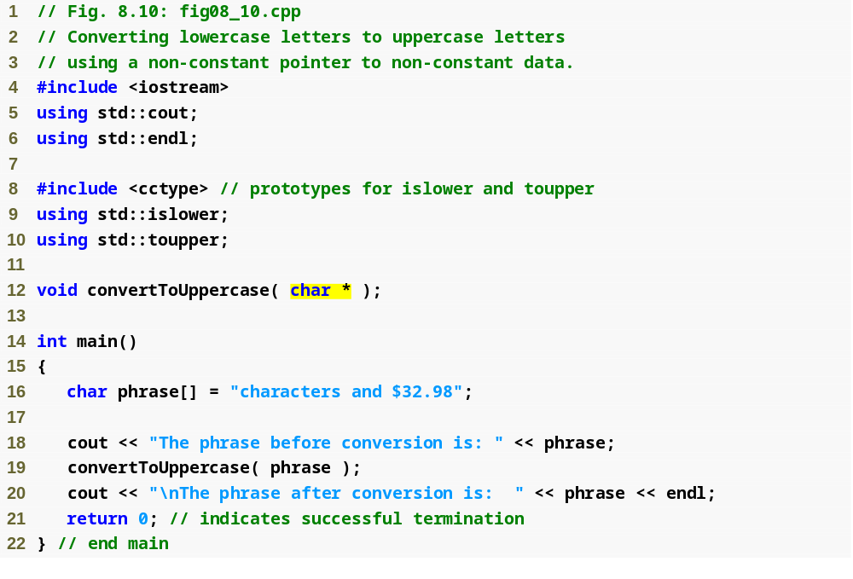
Outline
fig08_10.cpp
(1 of 2)
Parameter is a nonconstant pointer to nonconstant data
convertToUppercase modifies variable phrase

Slide 71
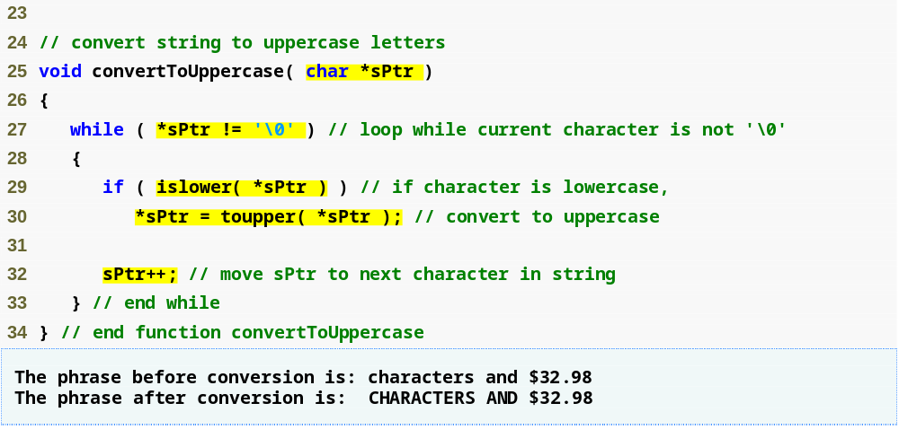
Outline
Parameter sPtr is a nonconstant pointer to nonconstant data
Function islower returns true if the character is lowercase
fig08_10.cpp
(2 of 2)
Function toupper returns corresponding uppercase character if original character is lowercase; otherwise toupper returns the original character
Modify the memory address stored in sPtr to point to the next element of the array

Slide 72
Using const with pointers (cont.)
Four ways to pass pointer to function (Cont.)
  Nonconstant pointer to constant data
    Pointer can be modified to point to any appropriate data item
    Data can NOT be modified through this pointer
    Provides the performance of pass-by-reference and the protection of pass-by-value
    This type of pointer might be used in a function that receives a pointer to an array as a parameter and processes that array but should not be allowed to modify any of the array's data
      Any attempt to modify the data the pointer points to in the function will result in a compilation error
        In this case you will put const to the left of the pointers type
        const int *countPtr; - countPtr is a pointer to an integer constant – PAY ATTENTION TO WHERE CONST IS
Example 19
Example 19a

Slide 73
Performance Tip
If they do not need to be modified by the called function, pass large objects using pointers to constant data or references to constant data, to obtain the performance benefits of pass-by-reference.

Slide 74
Software Engineering Observation
Pass large objects using pointers to constant data, or references to constant data, to obtain the security of pass-by-value.

Slide 75
Using const with pointers (cont.)
Four ways to pass pointer to function (Cont.)
  Constant pointer to nonconstant data
    Always points to the same memory location
      Can only access other elements using subscript notation
    Data CAN be modified through the pointer
    Default for an array name
      Can be used by a function to receive an array argument
      An array name is a constant pointer to the beginning of an array by default, the data it points to can be changed but not the memory location of the beginning of the array
    the POINTER must be initialized when declared
      This is done automatically with an array but not with a non-array const pointer
  Example 20

Slide 76
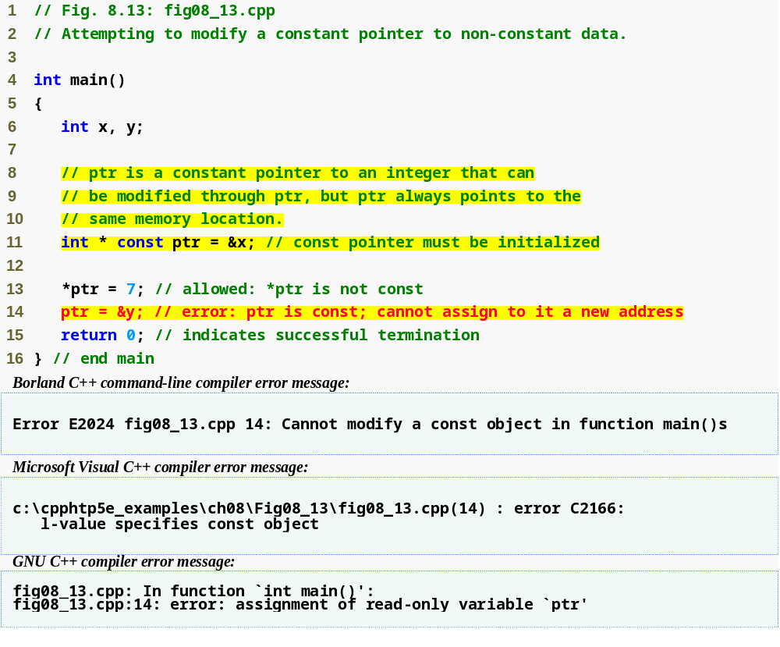
Outline
fig08_13.cpp
(1 of 1)
ptr is a constant pointer to an integer
Can modify x (pointed to by ptr) since x is not constant
Cannot modify ptr to point to a new address since ptr is constant
Line 14 generates a compiler error by attempting to assign a new address to a constant pointer

Slide 77
Common Programming Error
Not initializing a pointer that is declared const is a compilation error.

Slide 78
Using const with pointers (cont.)
Four ways to pass pointer to function (Cont.)
  Constant pointer to constant data
    Least amount of access
    Always points to the same memory location
    Data cannot be modified using this pointer
    This is how an array should be passed to a function that only reads the array and does not modify the array.
    Example notation:
      const int *const ptr = &x;
Example 21

Slide 79
Functions that return "const"
This is something not in the book I always found confusing so I looked it up
Of the possible combinations of pointers and ‘const’, the constant pointer to a variable is useful for storage that can be changed in value but not moved in memory.
Even more useful is a pointer (constant or otherwise) to a ‘const’ value. This is useful for returning constant strings and arrays from functions which, because they are implemented as pointers, the program could otherwise try to alter and crash. Instead of a difficult to track down crash, the attempt to alter unalterable values will be detected during compilation.
  For example, if a function which returns a fixed ‘Some text’ string is written like
  char *Function1()
  { return “Some text”;}
  then the program could crash if it accidentally tried to alter the value doing
    Function1()[1]=’a’;
whereas the compiler would have spotted the error if the original function had been written
const char *Function1()
{ return "Some text";}
because the compiler would then know that the value was unalterable.

